Slide 1


Library Management System with Python and Mongodb
SARATH KUMAR P 231801156
SABHARISHRAJA B 231801143
SABARISH P 231801142
1

Slide 2

Problem Statement
Libraries often struggle with manual processes for managing borrowing, returns, and member information, resulting in inefficiencies and errors. This leads to difficulties in maintaining accurate records and providing quality service. To resolve these challenges, an automated library management system is needed to streamline these tasks, create a reliable document-based database in MongoDB for storing library data, and design a user-friendly interface for both librarians and patrons.
2

Slide 3
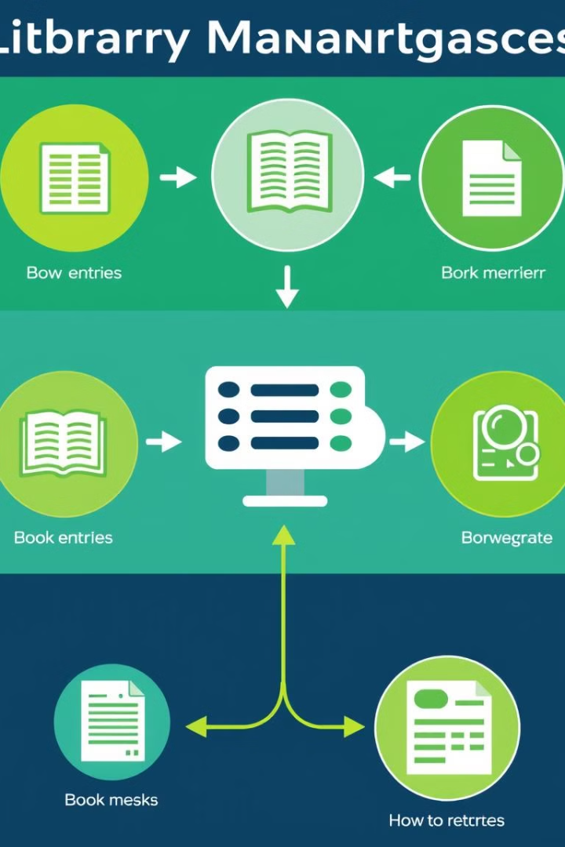
Objective
Automation
1
Automate library tasks like borrowing, returns, and member management.
Data Management
2
Create a database system to store library data.
User Interface
3
Design a user-friendly interface for librarians and patrons.
3

Slide 4

Introduction
Project Scope and Goals
1
The Library Management System using Python and MongoDB will automate user, book, and transaction management, providing efficient, secure, and scalable operations for a seamless library experience.
Project Challenges and Constraints
2
Implementation may face obstacles and resource constraints.
Project Approach and Methodology
3
The project uses Python’s Tkinter module and MongoDB.
4

Slide 5



Abstract
The project, 'Library Management System using Python and MongoDB,' is designed to streamline library operations by automating book availability, borrowing and returning processes, and managing customer and member details. Built on a client-server architecture, it uses MongoDB for database management and Python's Tkinter for a graphical user interface (GUI). The system aims to create a user-friendly experience, enhance data security, and reduce manual errors associated with managing library records. It provides scalable, efficient, and secure solutions for handling library data and interactions using a document-based database structure.
5

Slide 6




Existing System
High Initial Setup Cost:
Implementing an LMS can be expensive due to software, hardware, and installation costs.
Maintenance and Updates::
Regular maintenance and updates are required to keep the system functional and secure.
Data Security Concerns:
Storing user and library data poses risks if strong security measures are not in place.
6

Slide 7
Disadvantage of Existing System
High Initial Setup Cost:
Limited Accessibility:
Requires significant investment in software, hardware, and installation.
4
Access may be restricted to specific locations or devices, reducing user convenience.
Ongoing Maintenance and Updates
User Training Requirement:
5
Users and staff need training to navigate the system, adding time and resource costs.
Demands regular upkeep to remain functional and secure, adding to long-term costs.
Scalability Issues:
Data Security Concerns:
Adapting to higher user demands or larger libraries can be challenging and costly.
6
Storing user and library data poses risks without robust security protocols.

Slide 8

Proposed System
Cost Management :
Opt for scalable, open-source, or cloud-based solutions to reduce initial setup costs and allow flexibility in budgeting.
Regular Maintenance and Support:
Schedule regular maintenance and establish a dedicated IT support team to handle updates and system health, ensuring smooth operations.
Strengthen Data Security:
Employ strong data encryption, user authentication protocols, and regular security audits to protect sensitive information and maintain privacy.
8

Slide 9
Advantages of Proposed System
Cost Efficiency:
Opting for open-source or cloud-based solutions reduces initial setup and maintenance costs, making the system more affordable in the long run.
Improved System Reliability:
Regular maintenance and a dedicated IT support team ensure system stability, reducing downtime and improving user satisfaction.
Enhanced Data Security:
Strong encryption, user authentication protocols, and frequent security audits safeguard sensitive information, ensuring privacy and data protection.
Scalability :
The system is designed to accommodate future growth, allowing for easy adaptation to increased user numbers or additional functionalities.
9

Slide 10
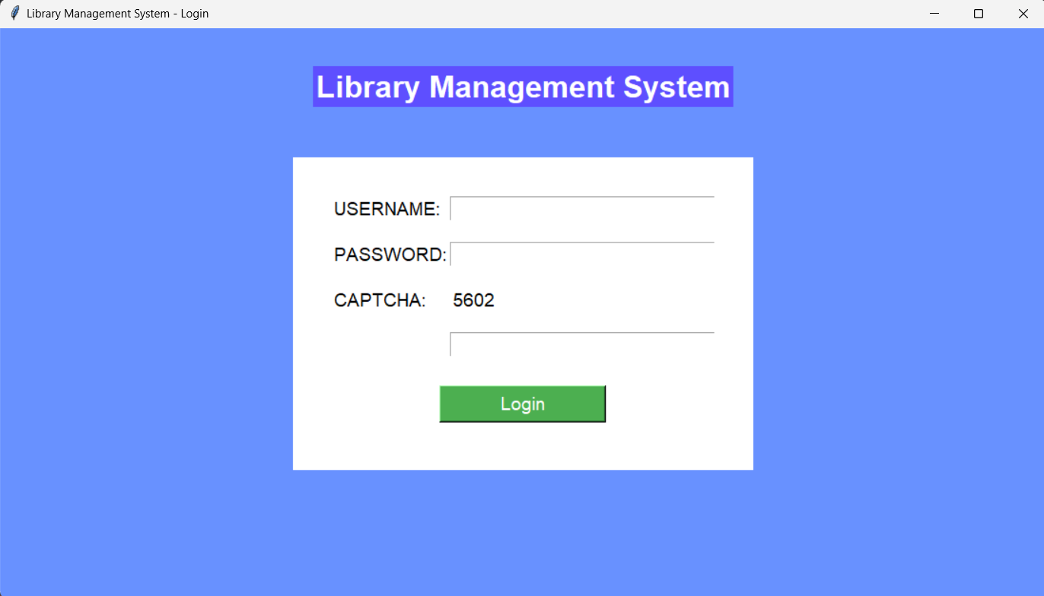
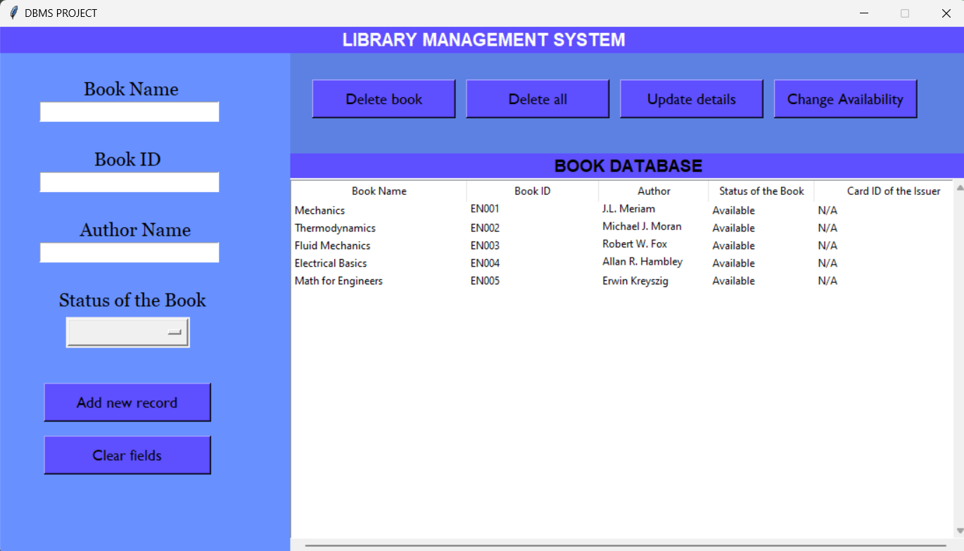
Output Screenshot
Login Page
Home Page
10

Slide 11
Library Management System Modules
Automation
Streamlines borrowing, returns, and member management.
Data Management
Provides a structured database for secure storage of library data.
Enhanced Data Security:
Intuitive interface for easy navigation by both librarians and patrons.
Security Protocols:
Uses encryption and authentication to safeguard user and library information.
Cost Efficiency
Utilizes open-source or cloud-based solutions to reduce setup and operational costs.
11

Slide 12
Sample Outputs
Cost Management :
Opt for scalable, open-source, or cloud-based solutions to reduce initial setup costs and allow flexibility in budgeting.
Regular Maintenance and Support:
Schedule regular maintenance and establish a dedicated IT support team to handle updates and system health, ensuring smooth operations.
Strengthen Data Security:
Employ strong data encryption, user authentication protocols, and regular security audits to protect sensitive information and maintain privacy.
12

Slide 13
Conclusion
The Library Management System with Python and MongoDB efficiently automates key tasks like borrowing, returns, and member management. It improves accuracy, reduces human error, and provides a user-friendly interface. Robust security protocols ensure data protection, supporting reliable and secure library operations with flexible document-based data storage.
Future Work
Mobile App Integration
Enable access to catalog and account info on mobile.
Cloud Hosting
Improve accessibility and scalability with cloud storage.
13

Slide 14
Reference:
➢ MongoDB Documentation: https://docs.mongodb.com/
➢ Python MongoDB Driver: https://pymongo.readthedocs.io/
➢ "Learning MongoDB" by Jason C. Brown
➢ Tkinter Documentation:
https://docs.python.org/3/library/tkinter.html
➢ Python Tkinter Tutorial (GeeksforGeeks):
https://www.geeksforgeeks.org/python-tkinter-tutorial/
10

